Slide 1
Predicting the severity of an accident — IBM Applied Data Science Capstone
Paul Moreira
October 2020

Slide 2
Introduction
According to the World Health Organization approximately 1.35 million people die each year as a result of road traffic crashes, and it costs most countries 3% of their gross domestic product. Traffic accidents cause economic losses to people and their families, and not only material losses because in the event of death or injuries, they affect several other aspects of the community. Starting from the premise that traffic accidents can be prevented, it is imperative to know the main factors that can cause an accident in order to develop strategies for the government or some organizations to act.

Slide 3
Problem
In Seattle, as it is for most cities in the world, it is necessary to implement initiatives to reduce the rates and severity of traffic accidents, so this project aims to predict whether the outcome of an incident is severe or not based on available data.

Slide 4
Interest
Drivers, pedestrians, cyclists could benefit from the results of the prediction, because they could act under certain conditions that are very likely to cause an accident. Government, traffic departments, police who need to take steps to create safe roads, build safer infrastructure, improve post-accident care for victims and raise awareness.

Slide 5
data
A comprehensive dataset consisting of road incident records that occurred between 2004 and October 16, 2020 in Seattle, obtained from the Seattle Open Data Portal 1. This dataset contains 221,524 rows and 40 columns, which describe the details of each incident, including location, severity, type of collision, fatality, date and time, weather, and road conditions, among others

Slide 6
Data handling
Relevant features
Incompleteness
Missing values
Correct data format
Normalization

Slide 7
Exploratory Data Analysis
First of all, it is important to know the data in order to observe the contribution that each characteristic has in the general dataset. In addition, through graphs we can contrast each of the characteristics with the target variable.

Slide 8

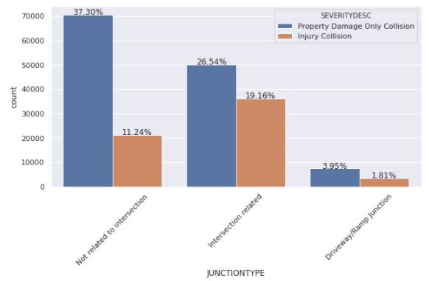
Junction Type vs Severity

Slide 9
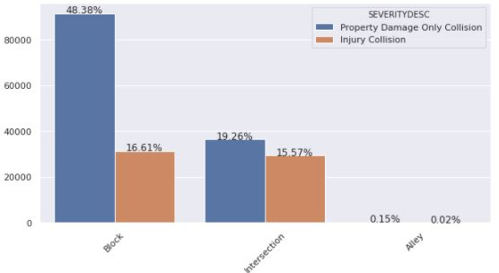
Address Type vs Severity

Slide 10
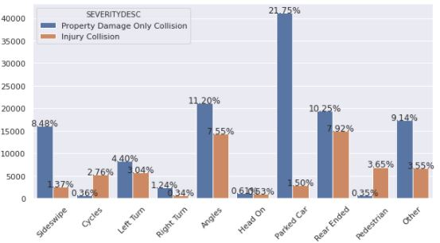
Collision Type vs Severity

Slide 11
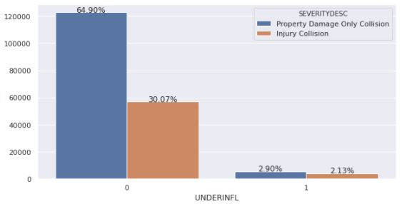
Under influence of drugs or alcohol vs Severity

Slide 12
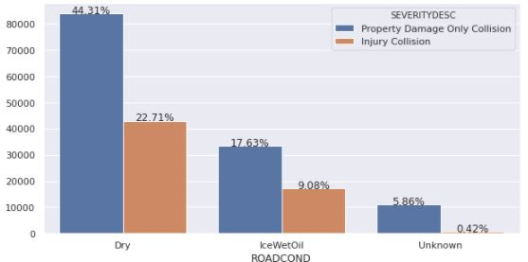
Road condition vs Severity

Slide 13
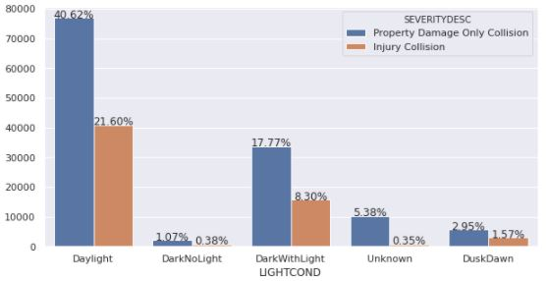
Light condition vs Severity

Slide 14
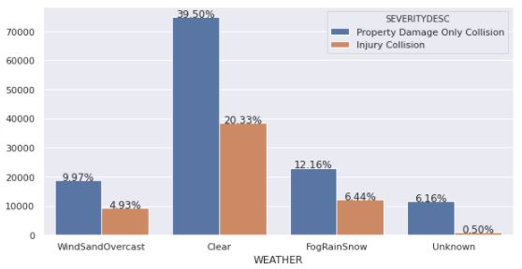
Weather vs Severity

Slide 15
Predictive modeling
We will try to predict the classification of an accident fatality using the machine learning models K-nearest Neighbor, Decision Tree Analysis and Logistic Regression.

Slide 16

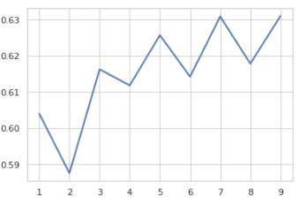
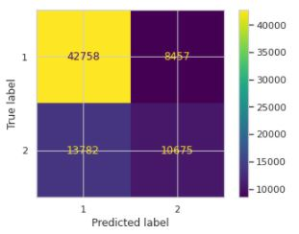
K-nearest neighbor
The accuracy of the k value increases as the value is also increase, therefore, the best k value is 9 with the accuracy of 0.63, as shown below.

Slide 17
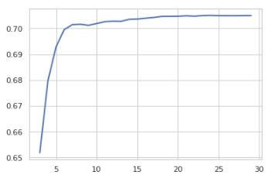
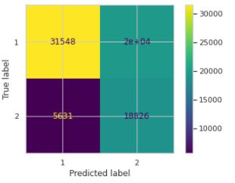
Decision Tree
The criterion chosen for the classifier was ‘entropy’ and the max depth was 24 with best accuracy of 70%

Slide 18
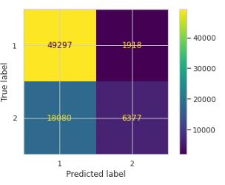
Logistic Regression
We use GridSearchCV to search the best parameters. The C used for regularization strength was ‘10.0’ and penalty was “l2” with the accuracy of 70%, whereas the solver used was ‘liblinear’

Slide 19
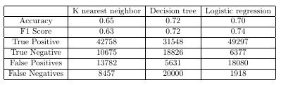
Performance of classification models

Slide 20
Conclusion
In this project we analyze the relationships between the severity of an accident and certain external characteristics such as weather, road and light conditions, collision and junction types among others. Through descriptive analysis it was possible to learn more about the features and data. Then, machine learning models were built to predict whether an accident has serious consequences or not. These models can be very useful in designing and implementing new politics and measures to avoid severities and fatalities in accidents.

Slide 21
Future directions
There were some characteristics that were not considered in this study, such as location and time characteristics, which may be important to consider in further studies. At various stages of the study, we found unbalanced data, so if we can improve the data set, for future performances the output from the models could get better. It is necessary to dig deeper to identify unrecognized factors and improve the accuracy of the models.

